Slide 1
Web-Sites
Polina Avsukevich

Slide 2




sites for learning programming
Code Conquest
Udacity
Dash

Slide 3


Code Conquest
Great website to help you learn the basics of programming. If you haven't written a single line of code in your life or don't even know what programming is, this platform will help you master the basics of development. On the site you will find many tutorials that will help you learn programming languages, such as: HTML and CSS JavaScript PHP Ruby Query Python

Slide 4

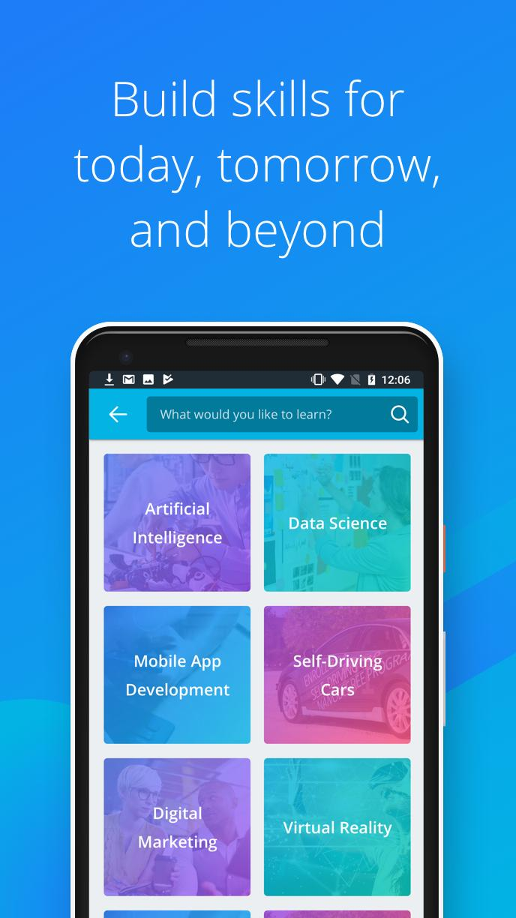
Udacity
Udacity- The site has a library of English-language video lectures, which have subtitles. There are also test tasks and homework. In this website you can find: life hacks for resume compilation; creating accounts in github;

Slide 5

Dash
Dash is a free website that will teach you the basics of web development in your browser. Using this site you will learn the basics of HTML5, CSS3 and Javascript, and how these languages work together to create a beautiful modern website. In addition, you can create a series of small projects that come together at the end to show how to create your own website.

Slide 6


sites for self-development
TheQuestion
Wikium

Slide 7


TheQuestion
A community of people who ask questions and who answer them. it is impossible to answer in two words: only detailed answers are needed. There are topics such as psychology, education, the brain, the theory of science, what to read, the inner world and, of course, self-development.

Slide 8


Wikium
Website for training attention, memory and thinking. The user is offered cognitive training games for the development of a particular brain function, as well as specialized courses for teaching various skills, abilities and skills that will definitely be useful in life. The number of users is already more than 3 million people worldwide.

Slide 9

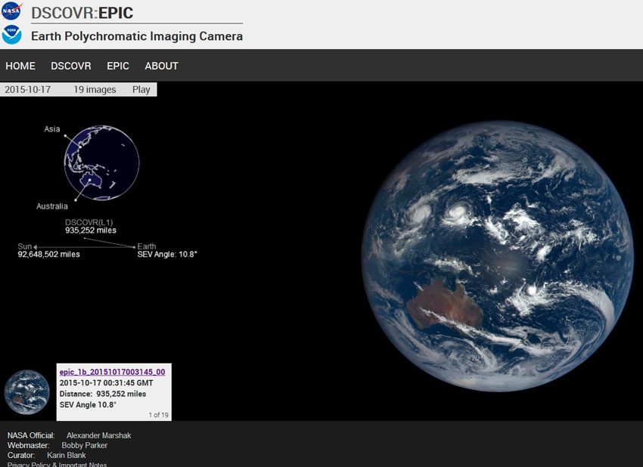
Nasa.gov
NASA has made a website where you can look at our planet from the outside, or rather from space, this site can be safely classified as interesting and useful sites for a little rest in the workplace. The images are constantly updated, so you will always see up-to-date images.

Slide 10
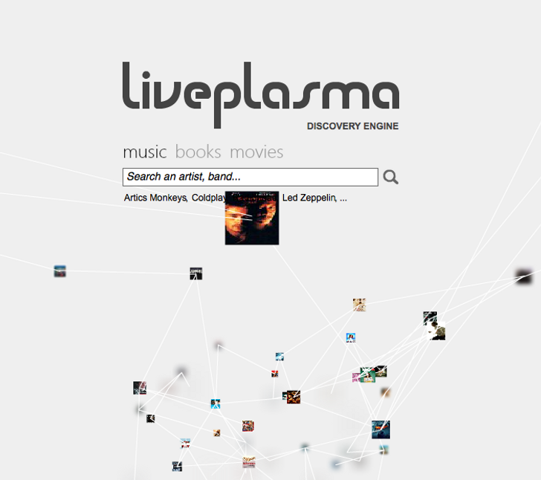
LivePlasma
Based on your preferences, the site will offer music and movies that you will definitely like. The site uses artificial intelligence.

